Slide 1
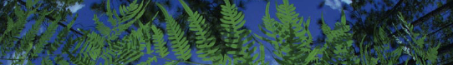

05 - Point Based
Shelly Gaynor
University of Florida

Slide 2
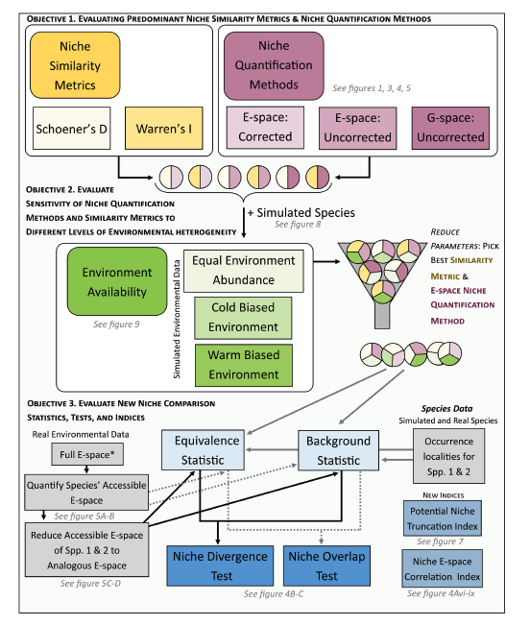
Climatic
Niche
Brown and Carnaval. 2019. A tale of two niche: methods, concepts, and evolution. Frontiers of Biogeography.

Slide 3
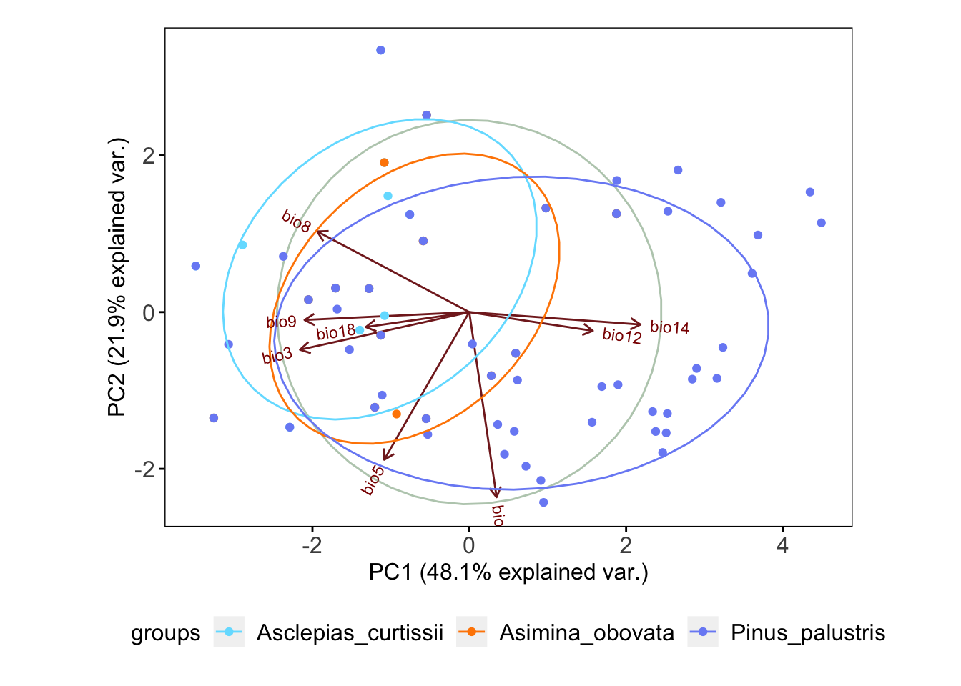
Ecological Niche
Realized Niche
abiotic conditions that a species can occupy with the presence of biotic interactions
Fundamental Niche
abiotic conditions a species could potentially occupy in the absence of biotic interactions

Slide 4
Ecological Niche
Realized Niche
abiotic conditions that a species can occupy with the presence of biotic interactions

Slide 5
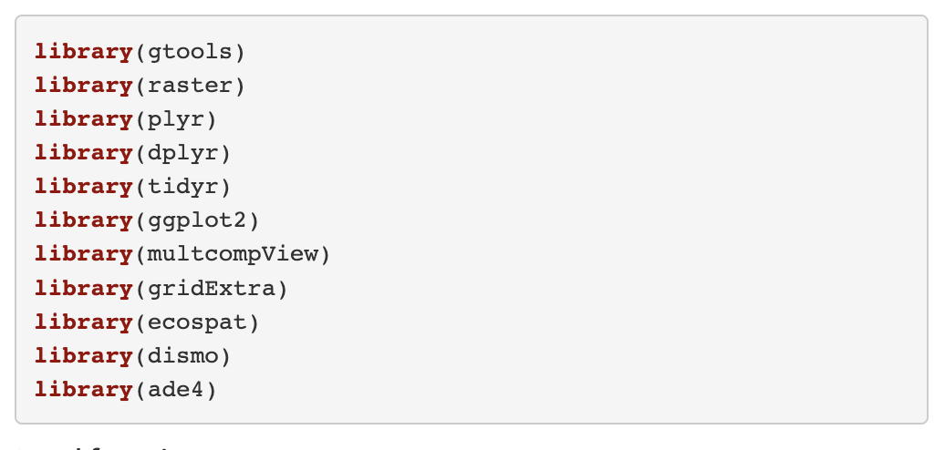
Load Packages

Slide 6
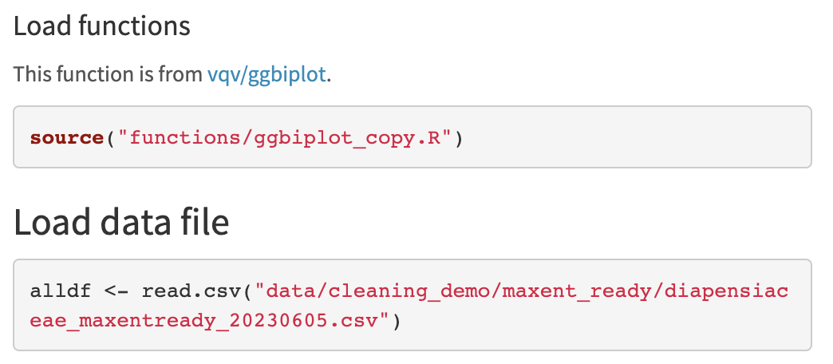
Load Datafiles

Slide 7
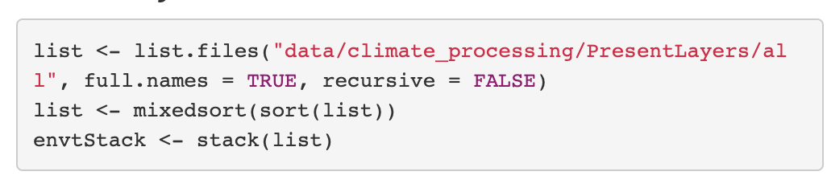
Load Raster Layers

Slide 8
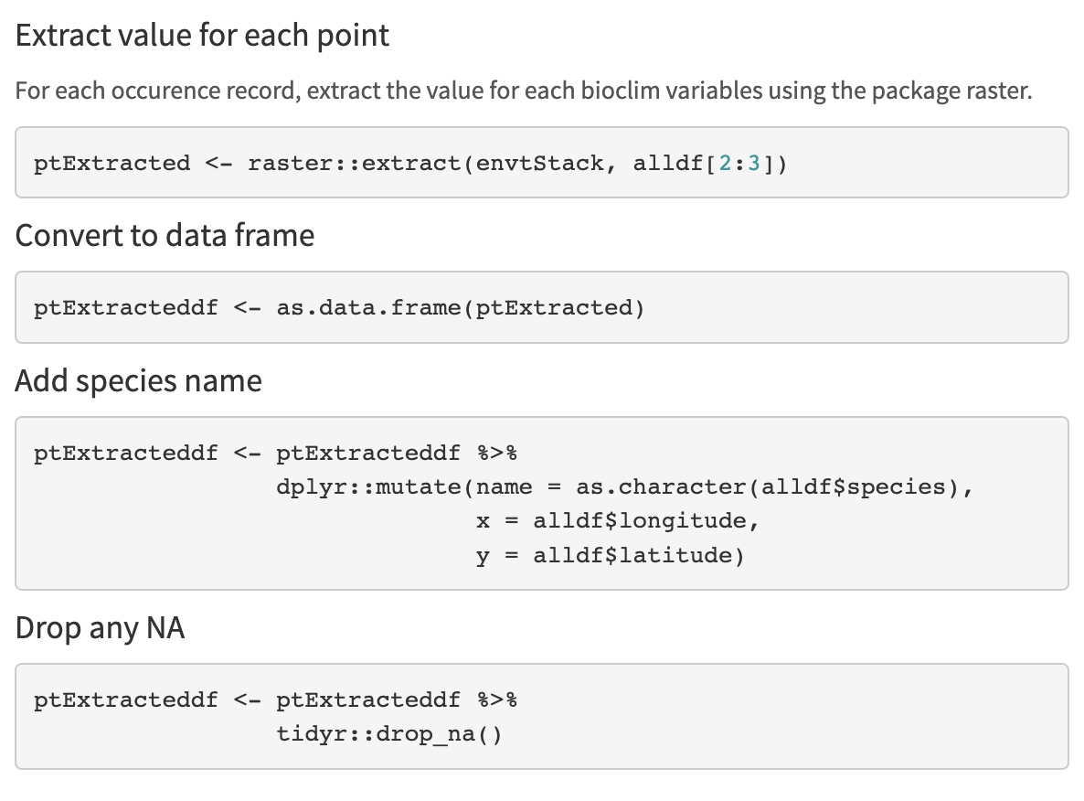
Preparing Data

Slide 9
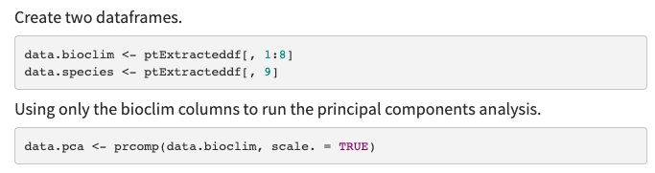
Principal Component Analysis
Notes:
“Principal component analysis (PCA) is a statistical procedure that uses an orthogonal transformation to convert a set of observations of possibly correlated variables into a set of values of linearly uncorrelated variables called principal components.”
– Wikipedia

Slide 10

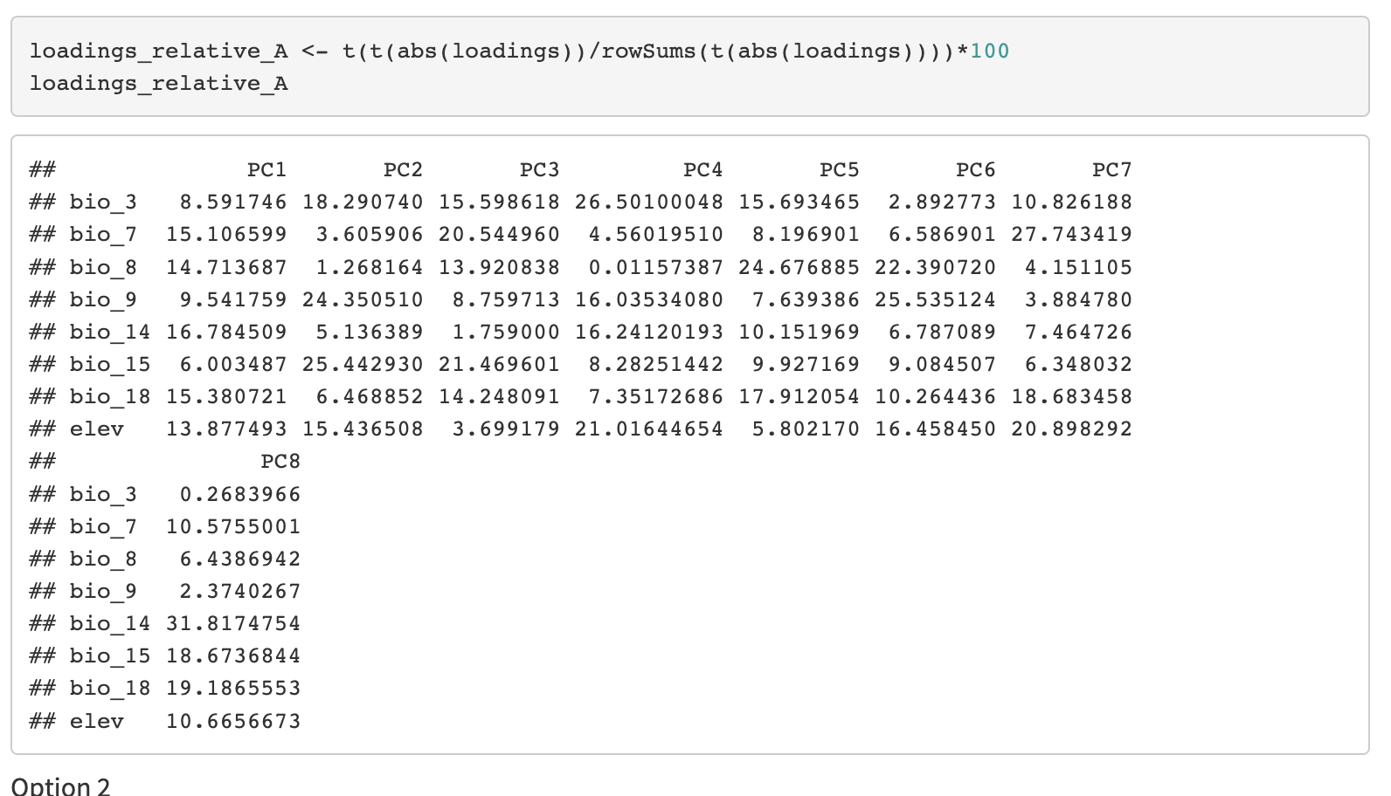
Principal Component Analysis

Slide 11
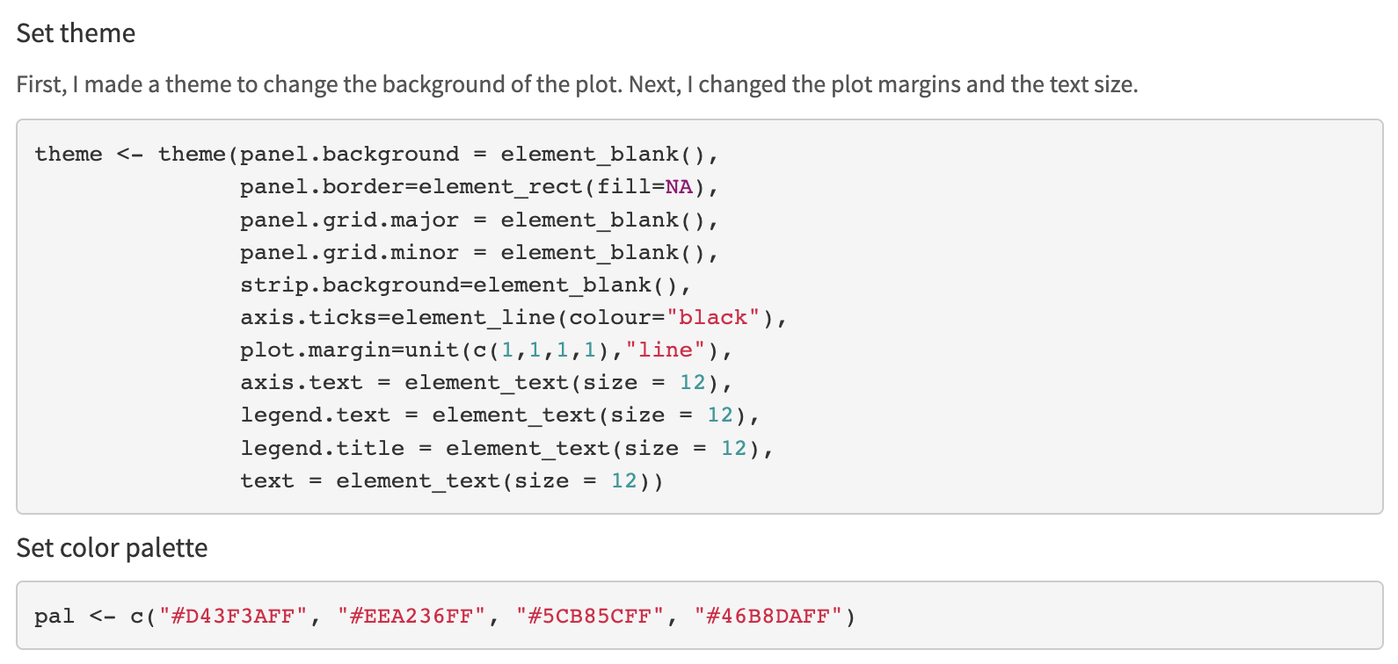
Principal Component Analysis

Slide 12
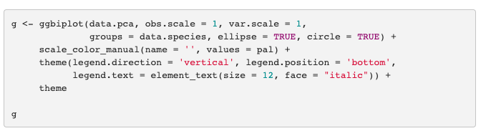
Principal Component Analysis

Slide 13
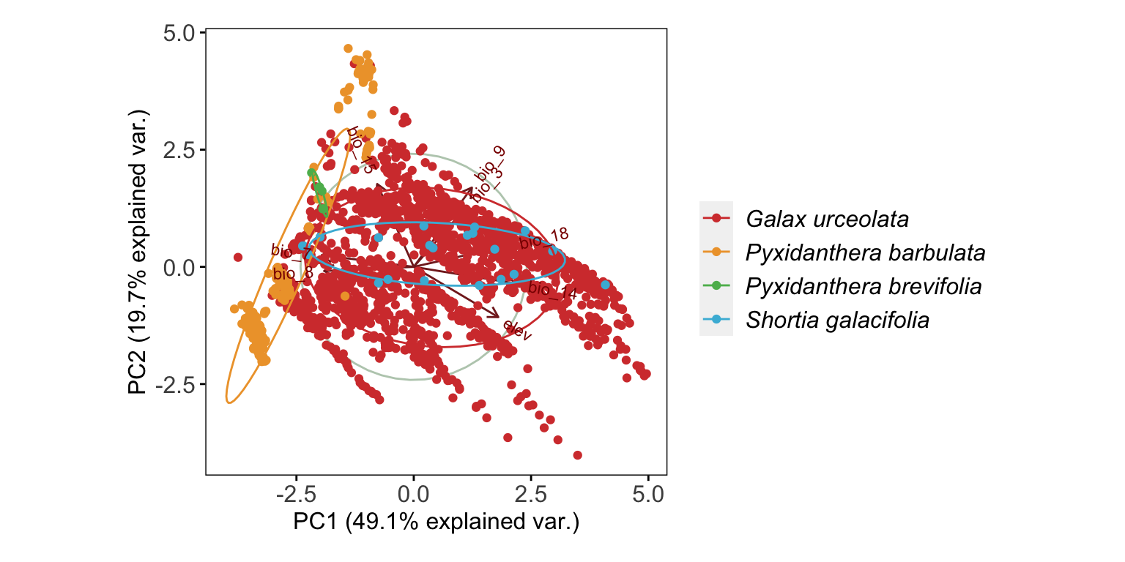
Principal Component Analysis

Slide 14
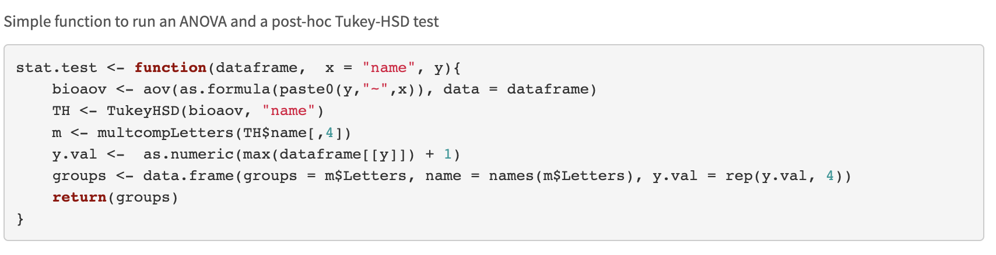
ANOVA
Notes:
Compares the means of more than two populations
Analysis of variance (ANOVA)
H_{o}: All the groups have equal means
H_{a}: At least one mean is different
Do levels significantly differ from each other?
post hoc tests using the Tukey Honest Significant Differences (TukeyHSD) method
This does as pairwise comparisons among means

Slide 15
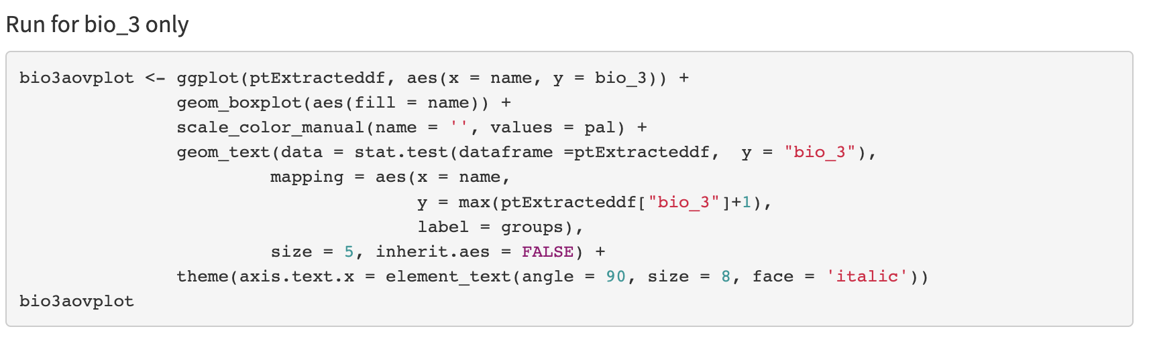
ANOVA

Slide 16
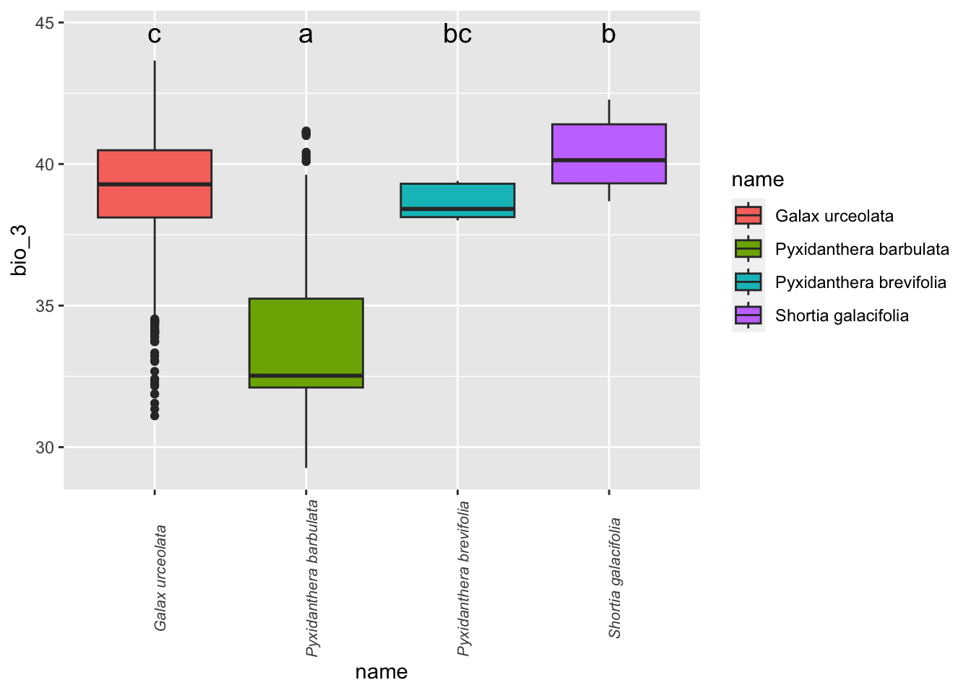
ANOVA

Slide 17
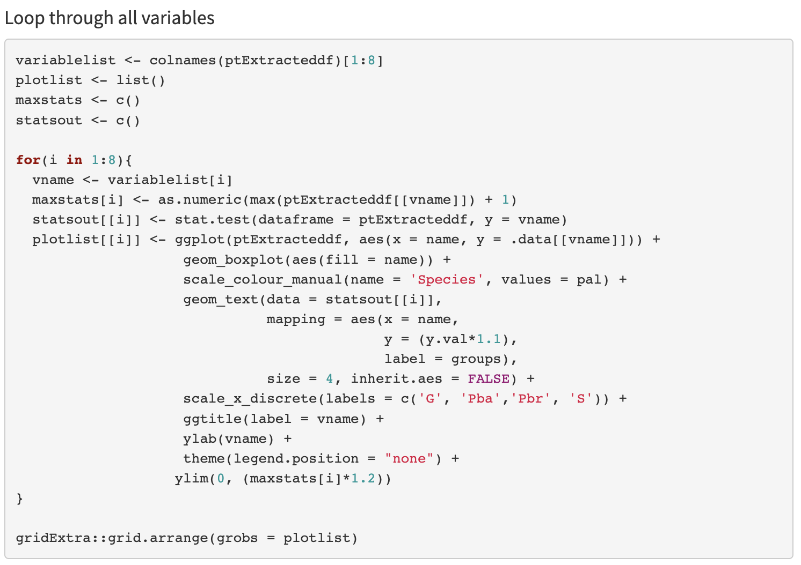
ANOVA

Slide 18
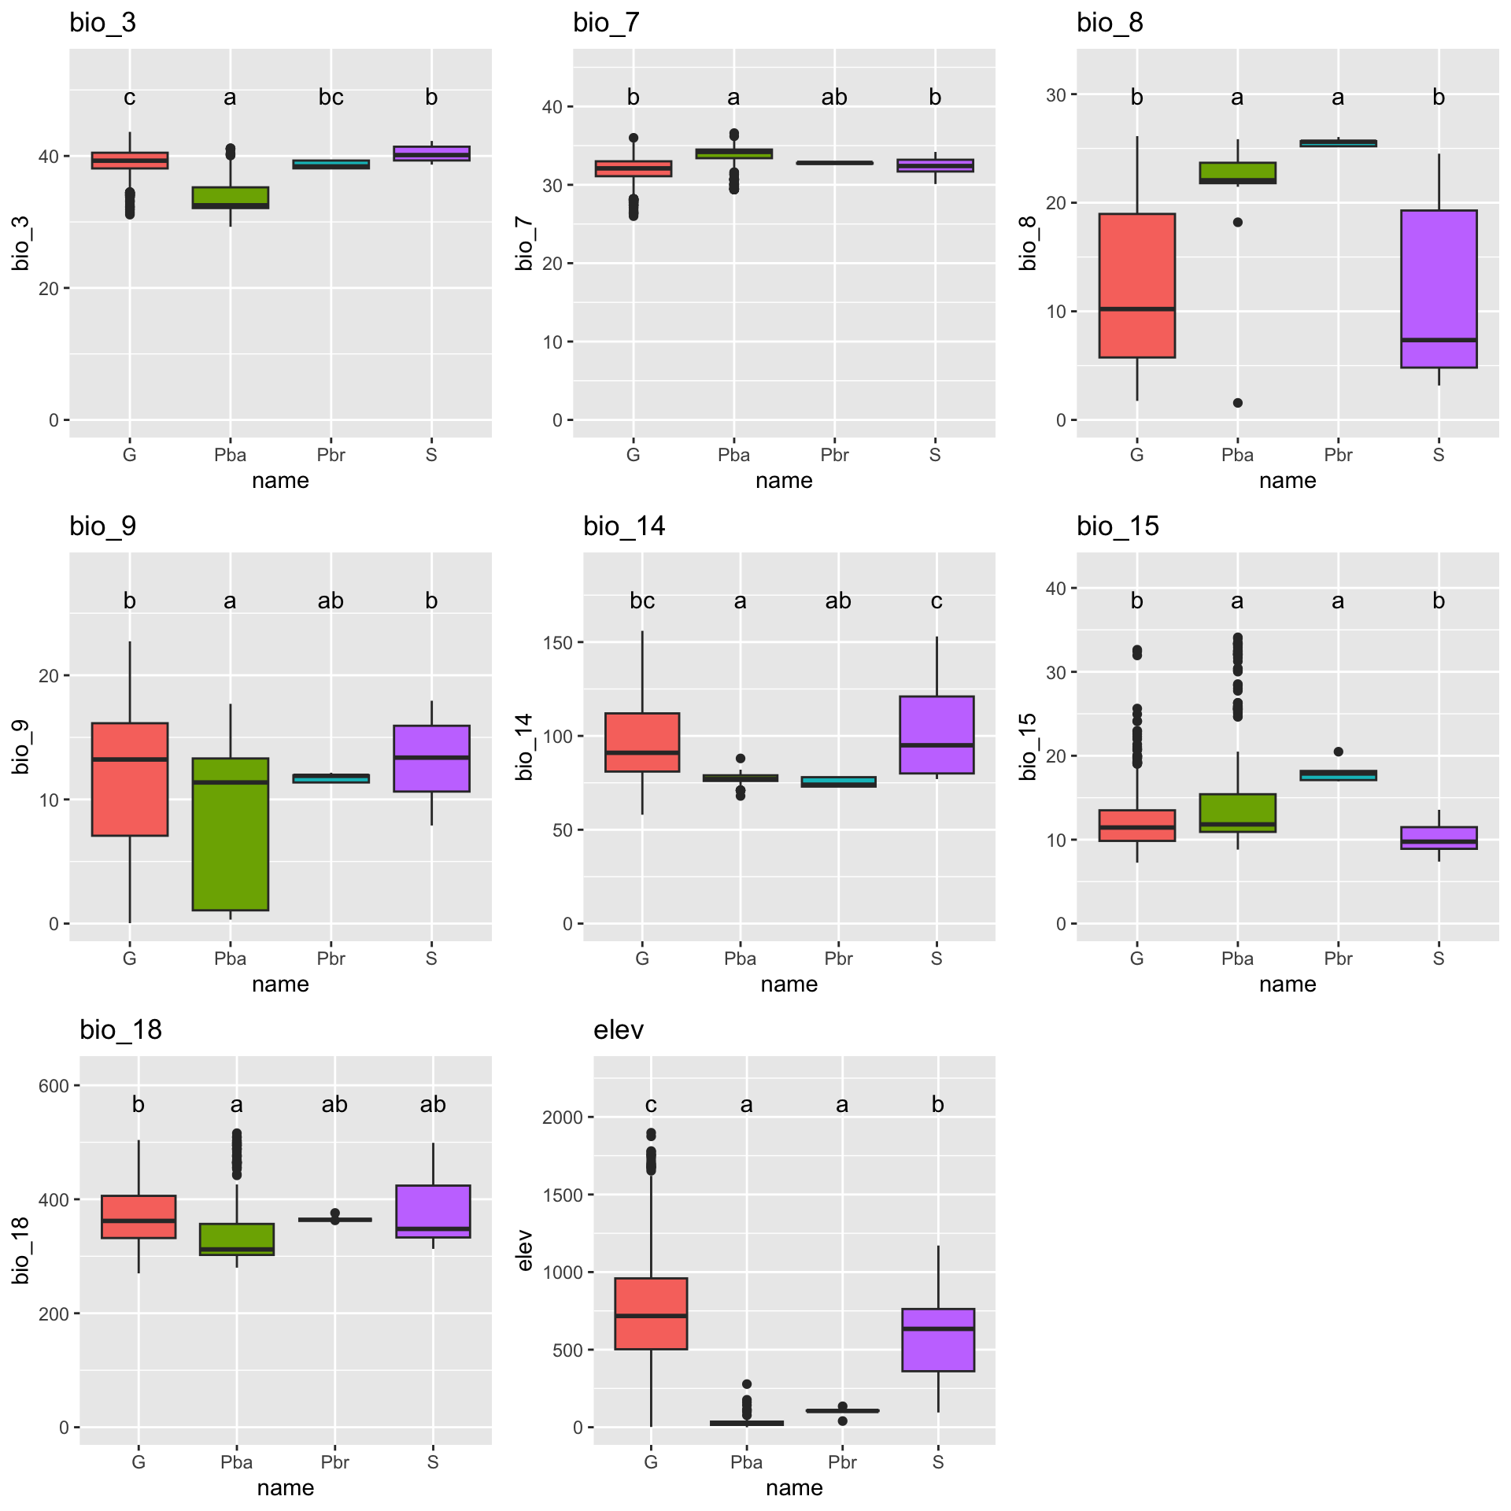
ANOVA

Slide 19
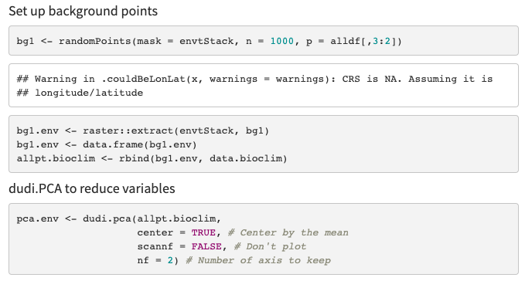
Ecospat

Slide 20
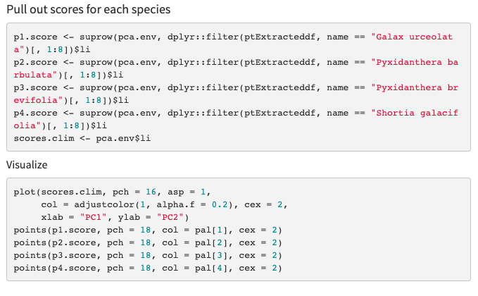
Ecospat

Slide 21
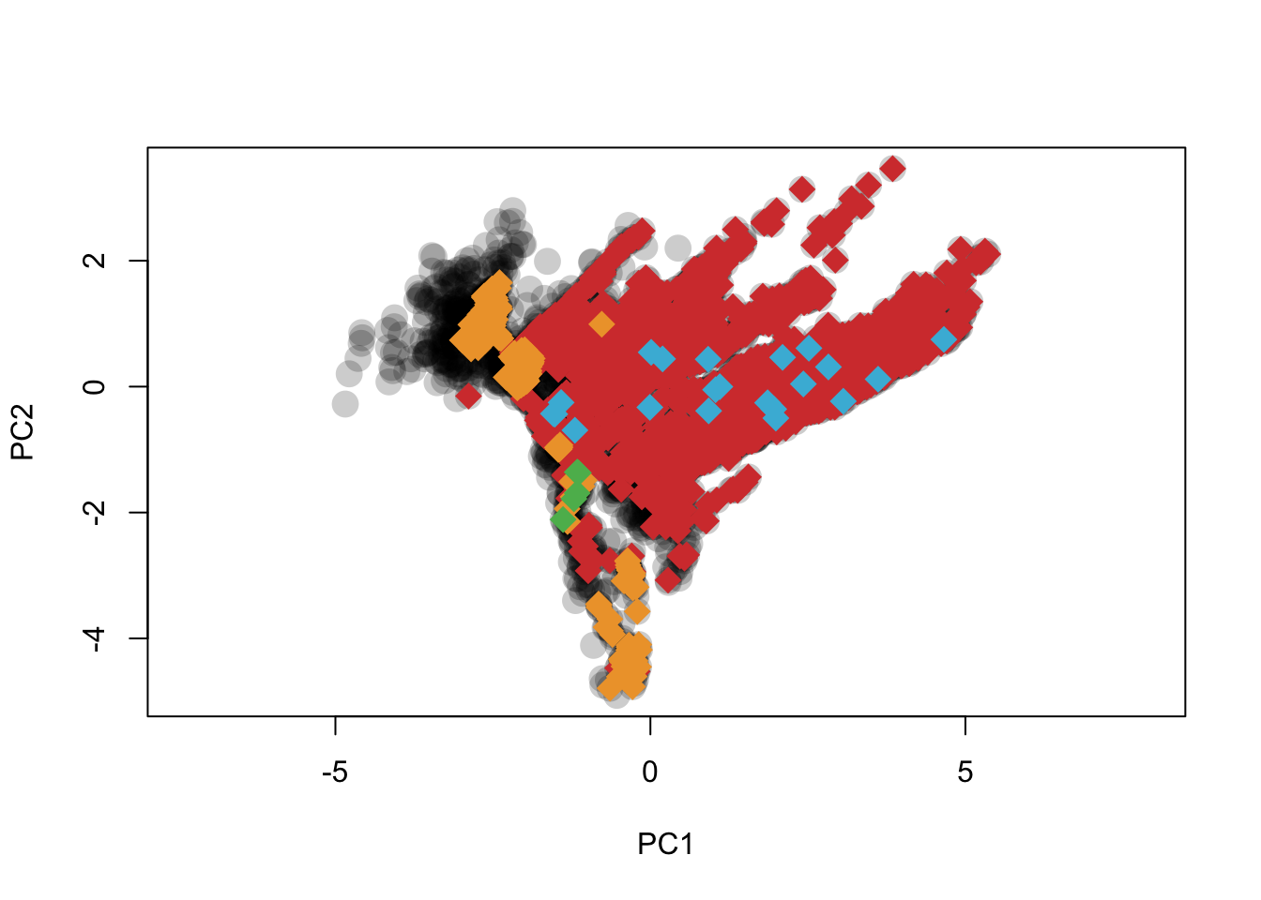
Ecospat

Slide 22
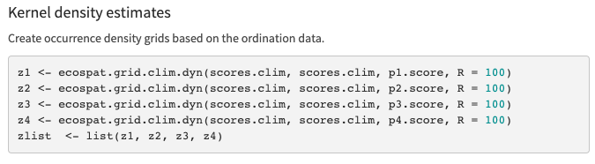
Ecospat

Slide 23
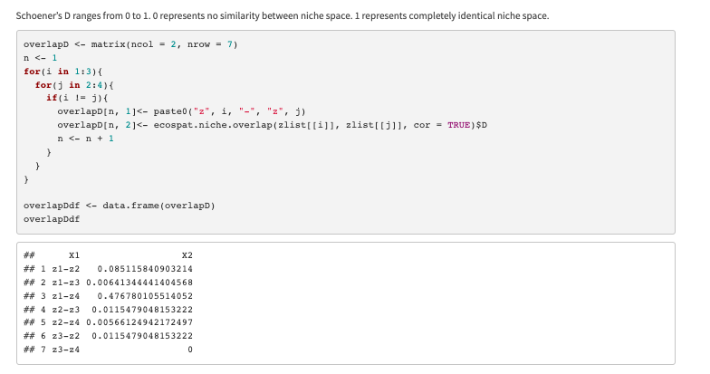
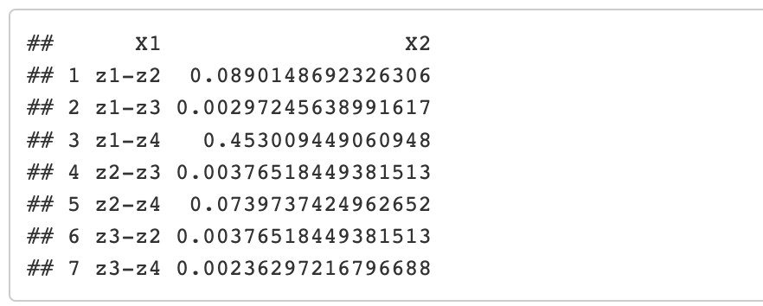
Niche Overlap

Slide 24
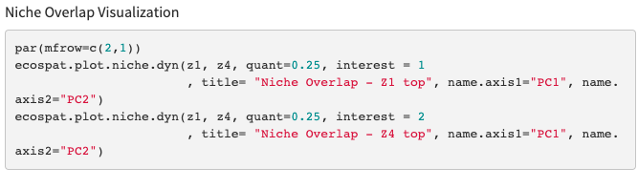
Niche Overlap

Slide 25
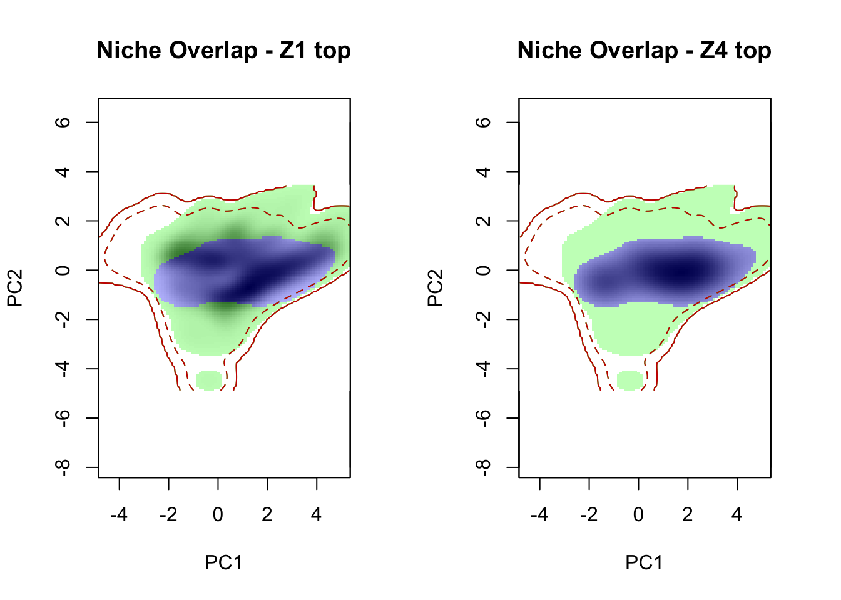
Niche Overlap

Slide 26
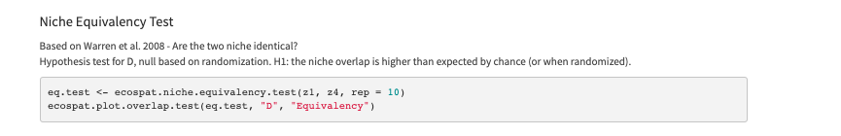
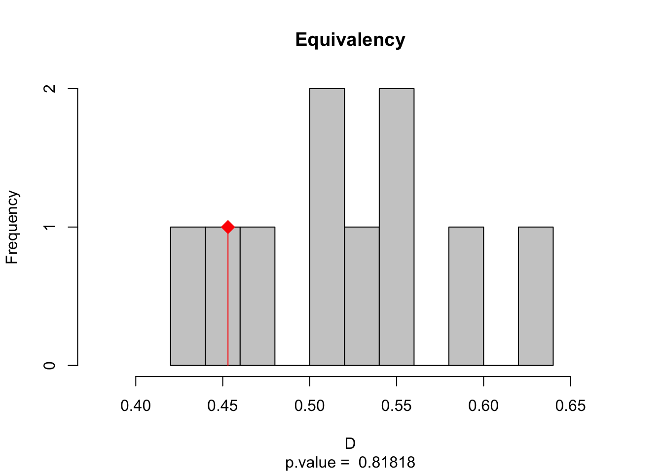
Niche Equivalency Test
Notes:
Based on Warren et al. 2008 - Are the two niche identical? Hypothesis test for D, null based on randomization. H1: the niche overlap is higher than expected by chance (or when randomized).

Slide 27
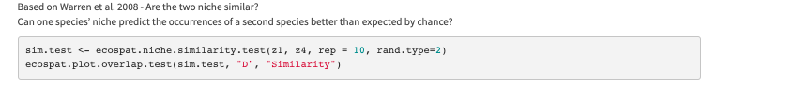
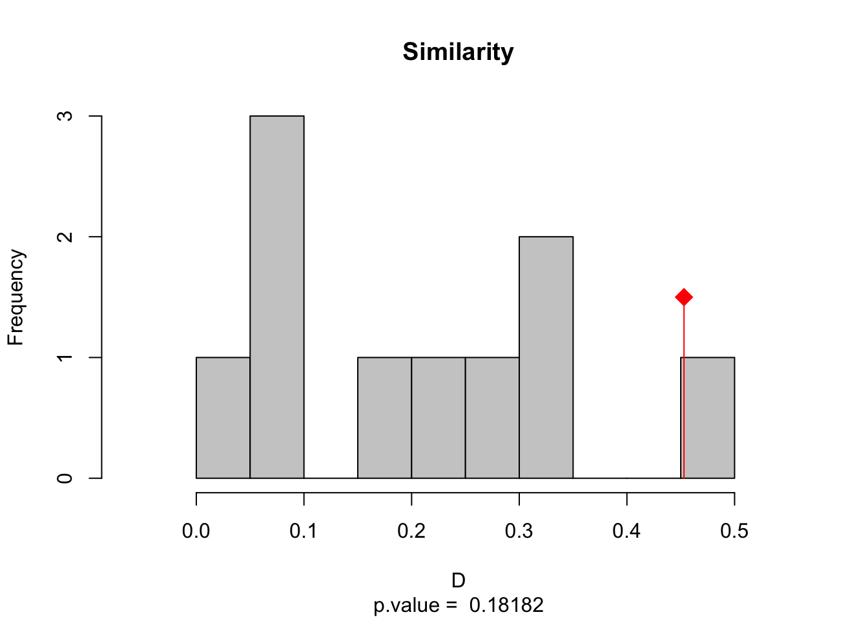
Niche Similarity Test
Notes:
Based on Warren et al. 2008 - Are the two niche similar? Can one species’ niche predicted the occurrences of a second species better than expected by chance.

